Slide 1
Chapter 2
BLOCKCHAIN TYPES AND CONSENSUS MECHANISM

Slide 2
Centralized Network
In centralized systems, only a central authority or administrator has the power to maintain and update the database.
All the data flows are controlled and managed by the central authority.
The central authority maintains the database by defining the rules and procedures users can have on adding, deleting, or updating the data.
All the nodes (computers and devices) connected to the network are subject to the access granted by the central authority.
In simple words, the central authority makes all the decisions. A failure at the center means the collapse of the entire system.
Central Server / Authority
Nodes
Centralized Network

Slide 3
Decentralized Network
A decentralized system does not rely on any single authority and is self-regulated.
Blockchain technology uses a decentralized P2P network architecture wherein anyone can be a node.
Every node is equal in the hierarchy with equal access to maintain the database.
Nodes
Nodes sharing the workload
Decentralized Network

Slide 4
Distributed Ledger Technology
In Blockchain technology, a distributed ledger is a decentralized ledger of all the information that is recorded onto the Blockchain by consensus.
One can imagine it to be a database similar to an accounting ledger where financial transactions are recorded, except that it is not restricted to financial data. Here a transaction refers to any digital data including text, picture, or audio files.
Unlike the typical database that is either centrally located in one server or spread out among several select servers, this database is distributed to all parties and locations.
It can be accessed by every single member of the Blockchain network, thus ensuring incorruptibility as malicious changes cannot be made when everyone has simultaneous access to all records.

Slide 5
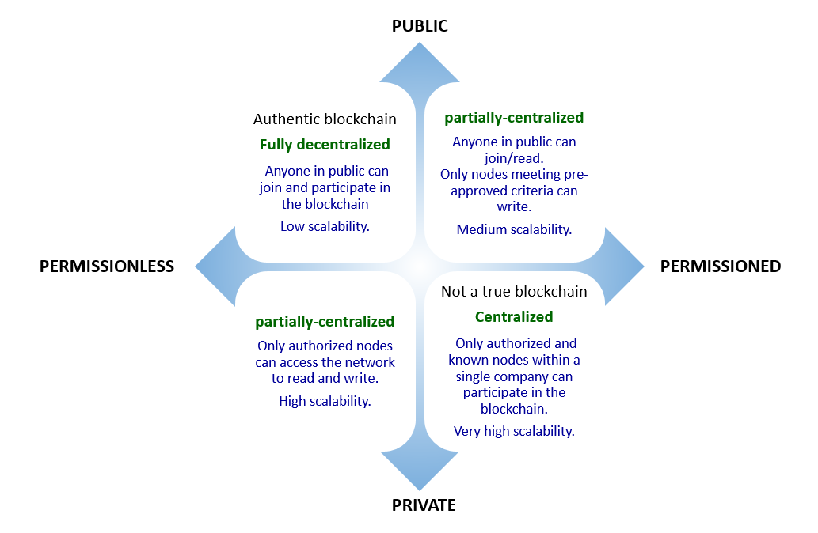
Types of Blockchain

Slide 6
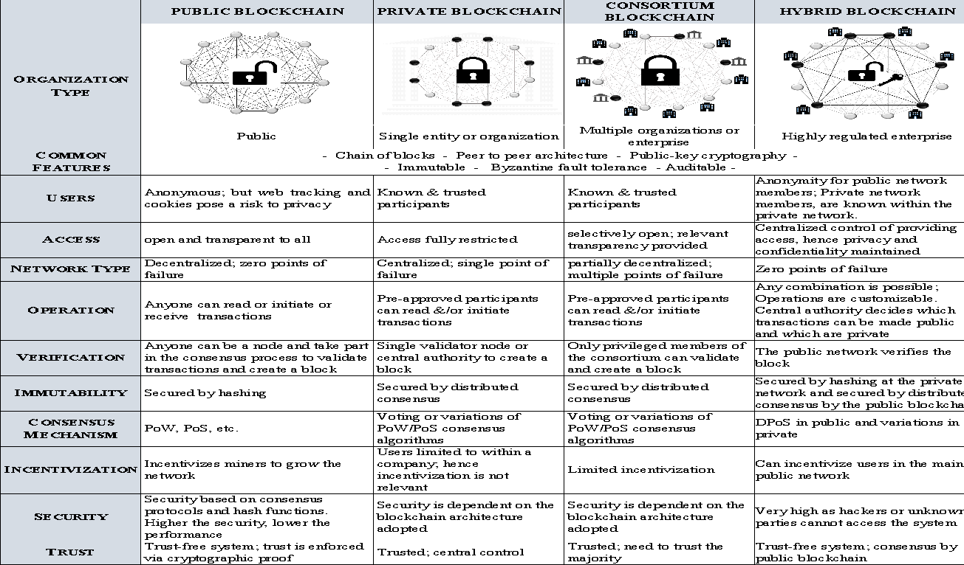
Types of Blockchain

Slide 7
What is Consensus?
As per Webster dictionary, a consensus is a general agreement or opinion shared by all the people in a group. A protocol is a system of standard rules that are acceptable by all parties to control the exchange of information in a network. Thus, a consensus protocol in Blockchain can be defined as a set of rules and procedures for attaining a unified agreement (consensus) between the participating nodes on the status of the network.
Consensus protocols are the rules that define how the different actors in a distributed ledger authenticate and validate the transactions added to it to prevent different versions of the ledger from being created or previous transactions from being edited.
The consensus protocol aims to overcome the classic problem of a distributed computing system known as the Byzantine Generals Problem.

Slide 8
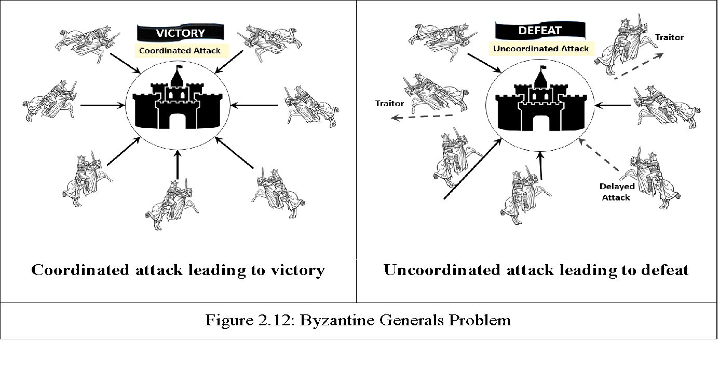
Byzantine General Problem

Slide 9






Objectives of Consensus Protocol
1.
2.
3.
Unified Agreement
Fault Tolerant
Collaborative and Participatory
4.
5.
6.
Egalitarian
Incentivisation
Prevent Double-Spend

Slide 10
Different Consensus Algorithms
Proof of Work (PoW)
Proof of Elapsed Time(PoET)
Proof of Stake (PoS)
Delegated Proof of Stake (DPoS)
Proof of Authority (PoA)
Practical Byzantine Fault Tolerance
RAFT

Slide 11
Other Consensus Algorithms
Proof of Stake Anonymous (PoSA):
Leased Proof of Stake (LPoS):
Proof of Importance (PoI):
Proof of Storage
Proof of Burn
Proof of Activity
Proof of Capacity
Directed Acyclic Graph (DAG)

